Slide 1
ECEG-5193: Algorithm Analysis and Design
Analysis of Sorting and Searching algorithms
2-3 Tree

Slide 2
2-3 Trees

Slide 3
2-3 Trees
Properties 2-3 Trees are balanced search trees.
Every node with children (non-leaf) has
either two children (2-node) and consists of one piece of data, or
has three children (3-node) and consists of 2 pieces of data.

Slide 4
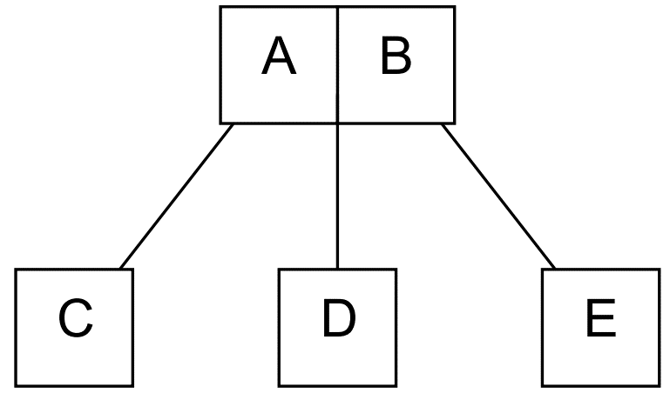
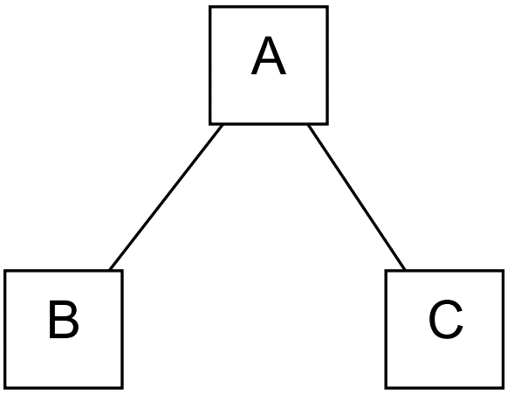
2-3 Trees
3-Node
Every non-leaf is a 2-node or 3-node
All leaves are at the same level
All non-leaves branch
All data is kept in sorted order
Every leaf node will contain one or two fields
Height ≤ lgn (More dense than BST)
2-Node

Slide 5
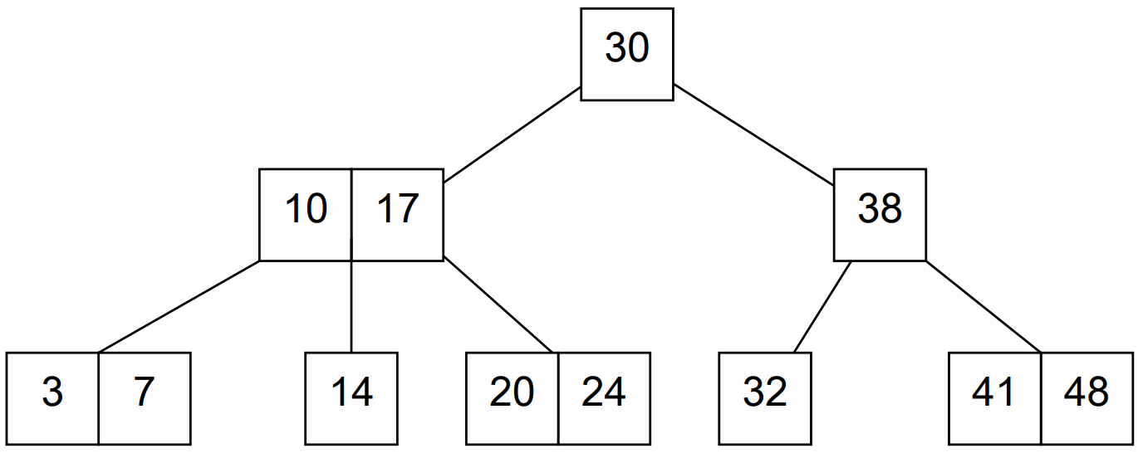
Example 2-3 Tree

Slide 6
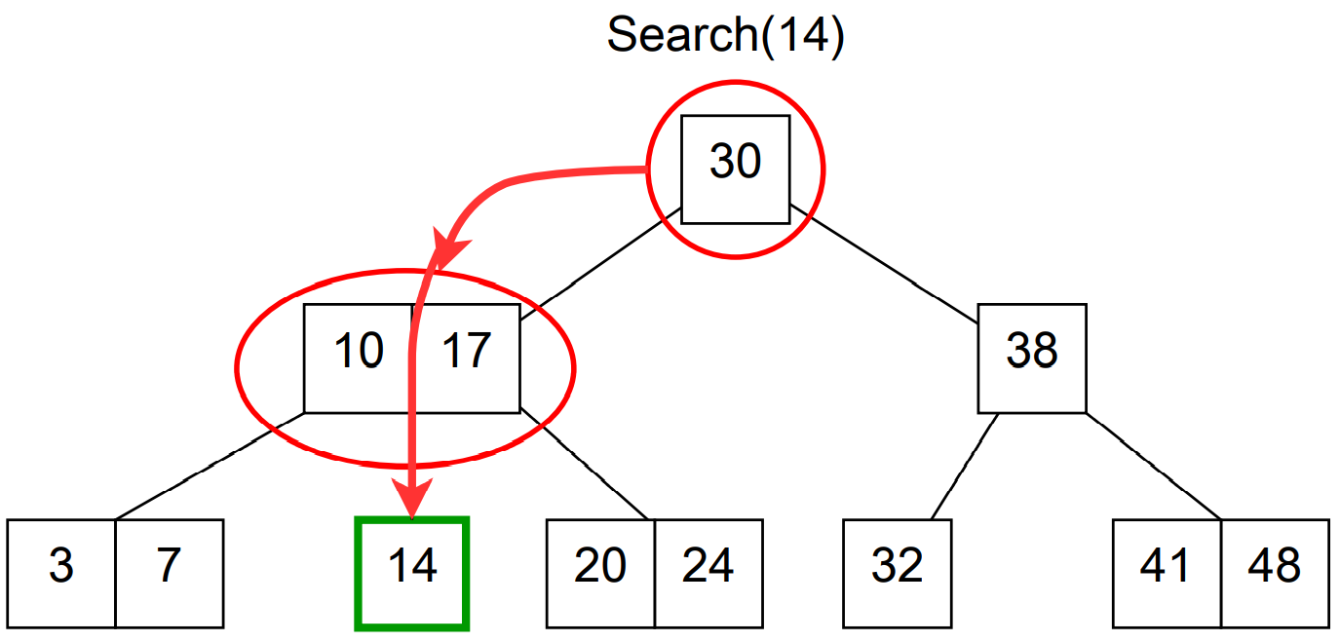
2-3 Tree - Search
Very similar to Binary Search.
Start at the root node, and traverse down tree in order.
Tree is sorted so only need to look at one node for each level of tree.
Search runtime is O(lg(n))

Slide 7
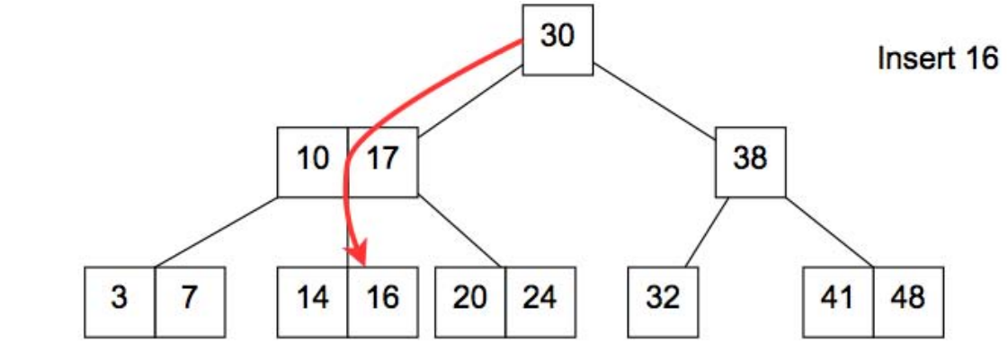
2-3 Tree – Insert Example

Slide 8
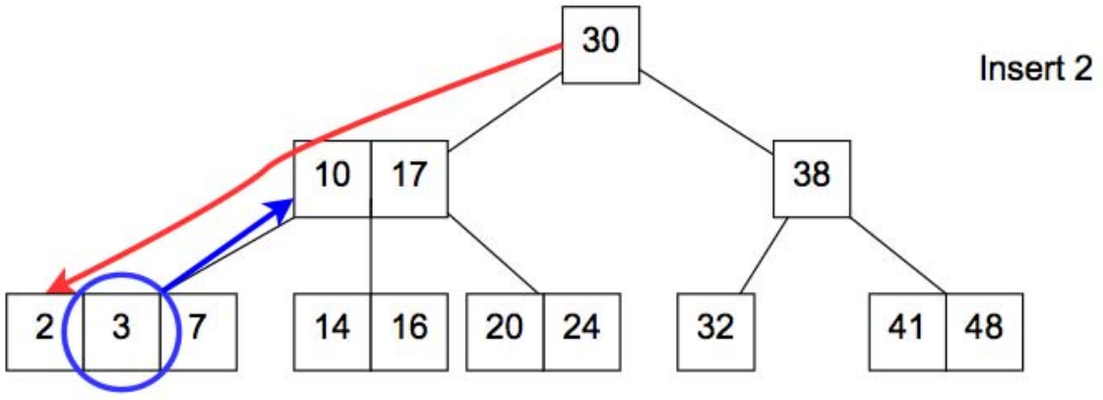
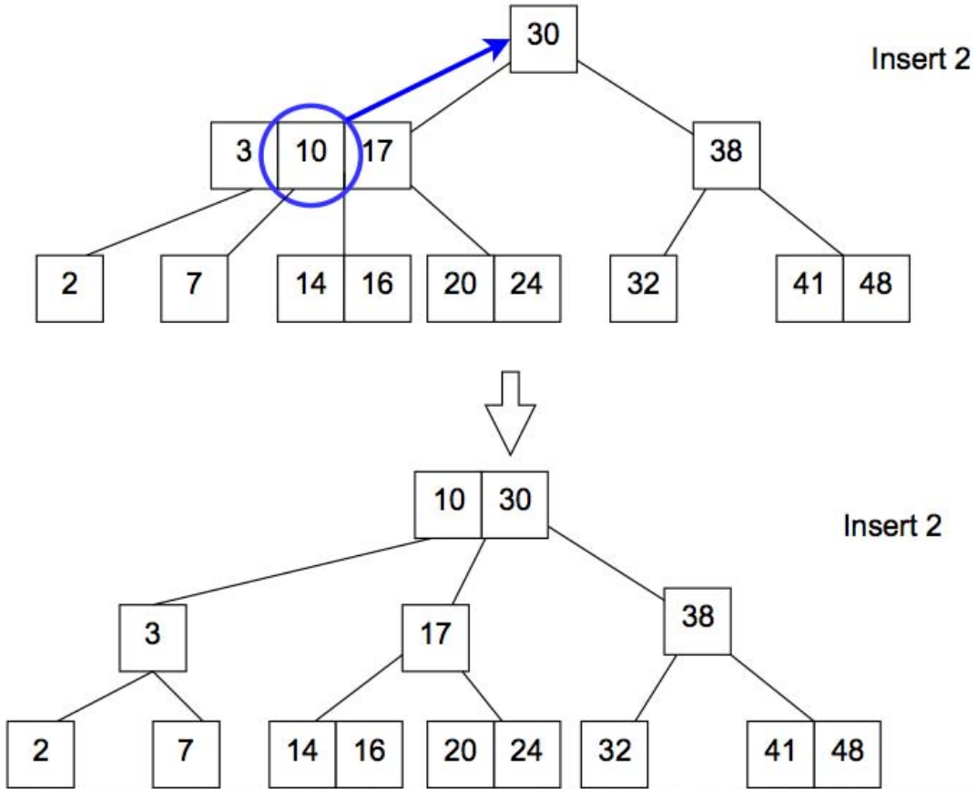
2-3 Tree – Insert Example

Slide 9
2-3 Tree – Delete
Delete(X) Steps:
Swap item to delete with inorder successor if item is not already a leaf.
Redistribute and merge nodes if there is underflowing in order to get back to a correct 2-3 tree
Runtime is O(lg(n))

Slide 10
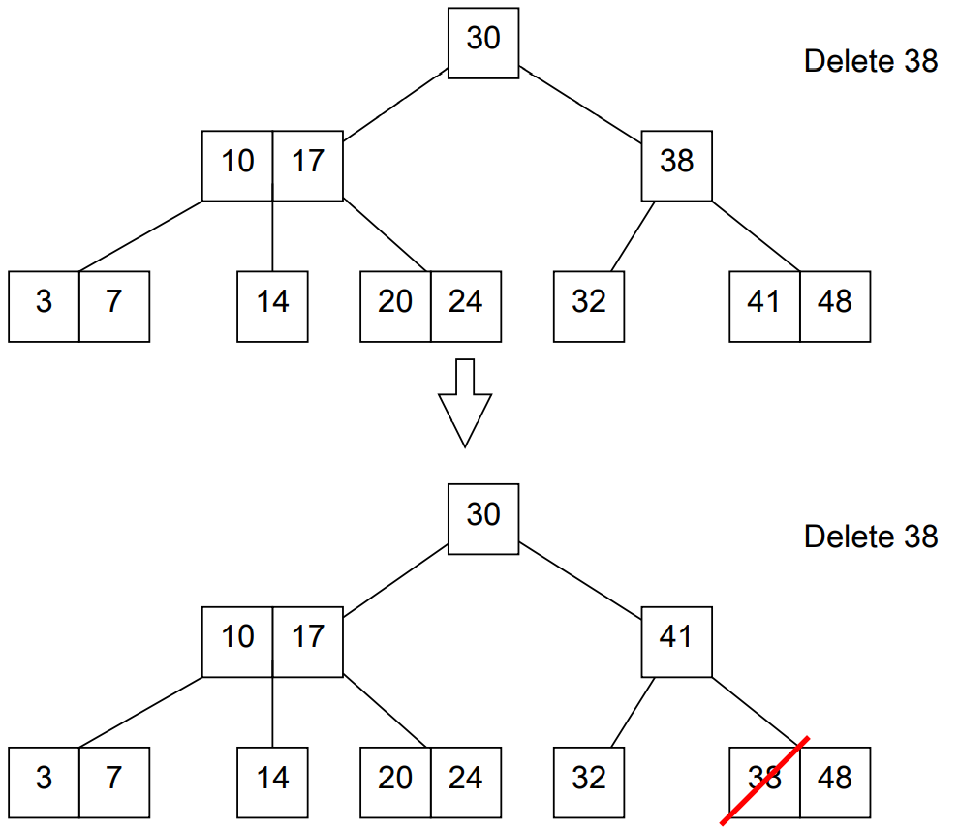
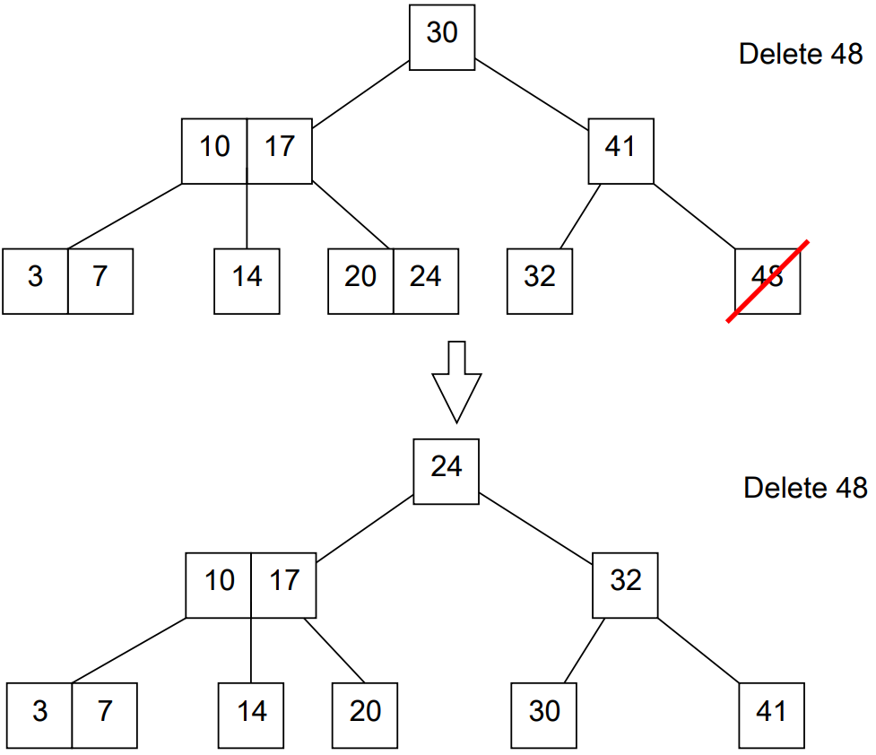
2-3 Tree – Delete: Redistribute Example

Slide 11
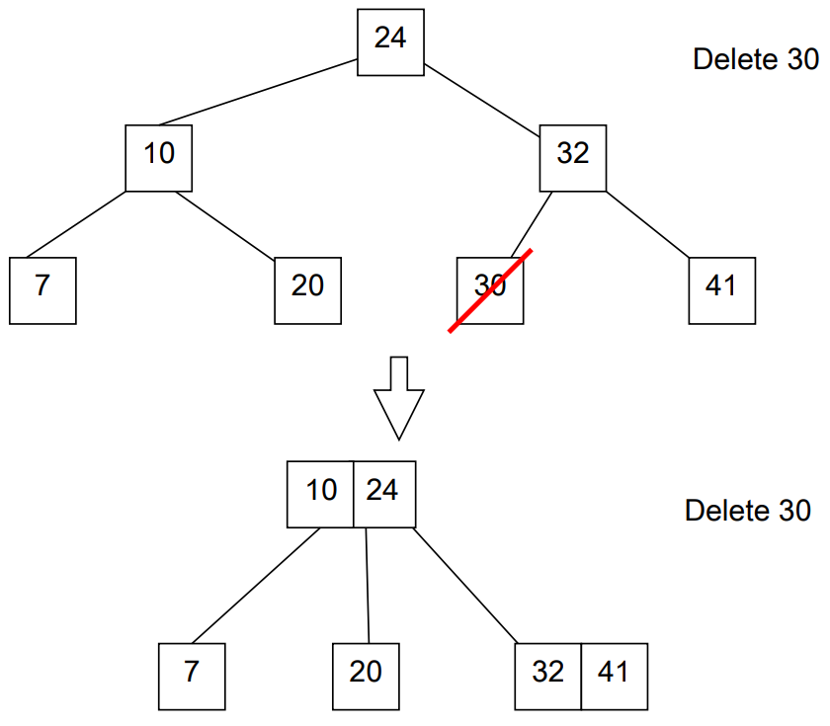
2-3 Tree – Delete: Merge Example

Slide 12
B-Trees
A B-tree has a parameter called the minimum degree or branching factor.
For the purposes of our discussion let the branching factor be B.
For any non leaf node, the number of children is one greater than the number of keys in that node.
Every non-root node contains at least B − 1 keys.
Consequently, all internal (non-leaf and non-root) nodes have at least B children.
Every node contains at most 2B −1 keys.
Consequently, all nodes have at most 2B children.
All the leaves are at the same depth.

Slide 13
Why B-Trees
Caches read whole blocks of data, and want entire block useful
Set parameter B equal to block size
O(log_{b}(n)) block reads per Search, Insert, Delete operations.
B-Trees are used by most databases and filesystems:
Databases: Sleepycat/BerkelyDB, MySQL, SQLite -Filesystems: MacOS HFS/HFS+, ReiserFS, Windows NTFS, Linux ext3, shmfs

